Slide 1

Skin Disease Detection
Presented By:- Guided By:-
Mr. Shivam Garg Ms. Divija Ameta

Slide 2
TABLE OF CONTENT
Skin Disease
Risk Factors
Types of skin disease
Objective
Block Diagram
Libraries Used
Data Flow Diagram
Result

Slide 3
SKIN DISEASE
Skin Disease is the most commonly diagnosed disease.
Skin Disease are either non-melanoma or melanoma.
Early detection and treatment can often lead to a highly favourable diagnosis
The visibility of the skin lessions increases the likelihood of early detection and diagnosis

Slide 4
RISK FACTORS FOR SKIN DISEASE
Damage in the ozone layer
Fair-skinned and fair-haired people due to insufficient skin pigmentation
Prolonged exposure to sun light
History of X-ray
Scars from severe bums
Chronic skin irritations
Immunosuppression
Genetic factors

Slide 5
Types of Skin Disease
The most common types of skin disease are:
Melanocytic nevi
Melanoma
Benign keratosis-like lesions
Basal cell carcinoma
Actinic Keratoses and Intraepithelial Carcinoma
Pyogenic Granulomas and Hemorrhage
Dermatofibroma

Slide 6
OBJECTIVE
This Process will depict the end-to-end process of building a flask API that accepts skin image as an input and detects the skin disease followed by sending medical report to patient and doctor through WhatsApp message.

Slide 7
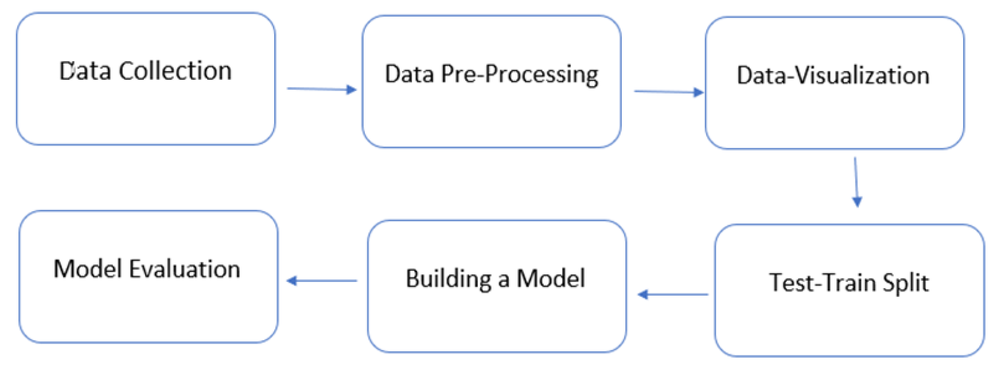
BLOCK DIAGRAM

Slide 8
Major Libraries Used
Pandas
Numpy
Matplotlib
Seaborn
Keras
Tensor Flow
Sklearn

Slide 9
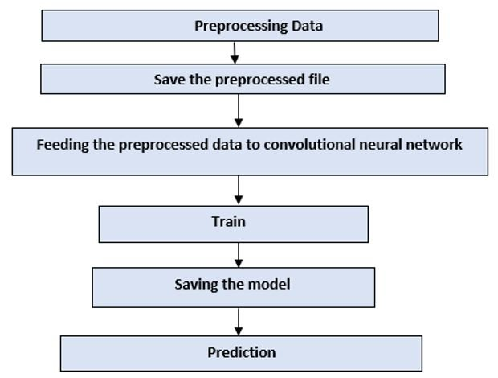
DATA FLOW DIAGRAM

Slide 10
Model Used CNN
The idea is to develop a simple CNN model from scratch , and evaluate the performance to set a baseline. The following steps to improve the model are:
Data augmentation : Rotations , noising , scaling to avoid overfitting
Transferred Learning : Using a pre-trained network construct some additional layer at the end to fine tuning our model
Full training and Evaluation

Slide 11
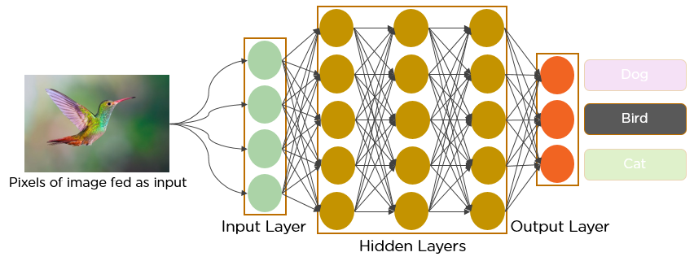
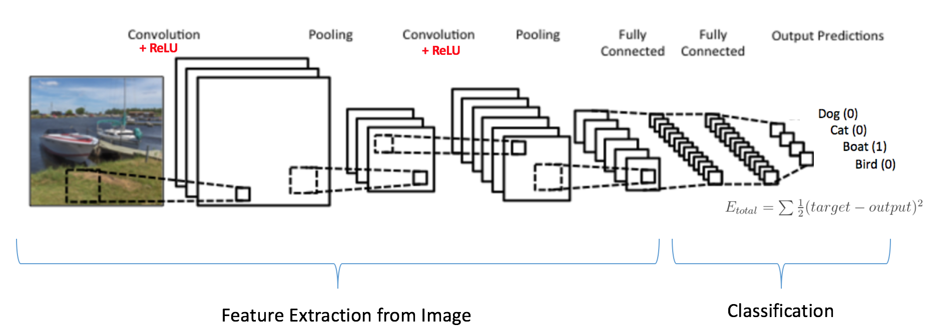
SAMPLE OF CNN WORKING

Slide 12
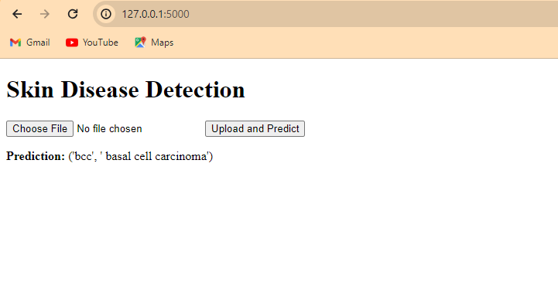
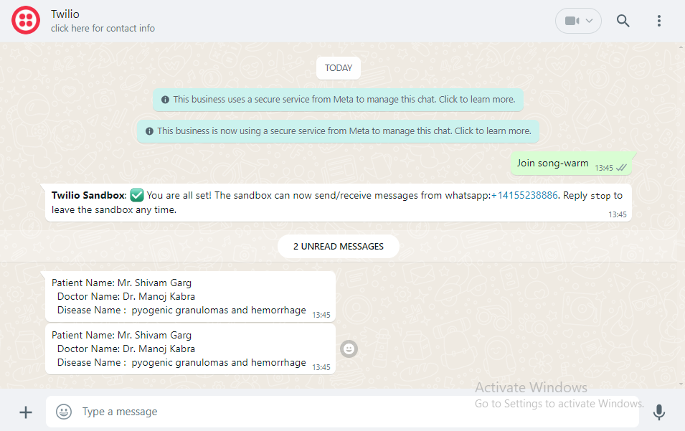
RESULT
If the confidence of model output is not greater than 80% then it is declared as 'No disease' class. Individual Whatsapp message is sent to patient and doctor, regarding disease class.
System successfully detects 7 different types of skin diseases with an accuracy rate of 88%.

Slide 13
Thank You

